Slide 1
1
Lignin-based elastomeric composites
Presented by
Jonathan Reggie Ebenezer
Guided by
Dr.Praveen KM
Prof.Rony Thomas Murickan

Slide 2
2
Introduction
Lignin-based elastomeric composite processing techniques
Challenges and Remedies
Performance of lignin-based elastomeric composites using different approaches
Application in Automotive parts
Conclusion
References
Outline
Relevance of the topic
Massive Abundance,
environmentally benign,
carbon neutral product, high biological efficiency, and
low weight.
Potential as a reinforcing filler and can enable the development of competitive elastomeric composites.

Slide 3
1.Introduction
Classification of Polymers
based on molecular forces
Thermoplastics
Thermosets
Elastomers
Fibers

Slide 4
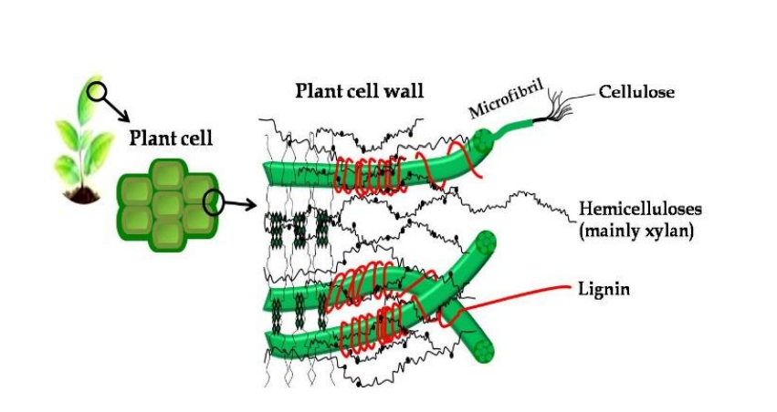
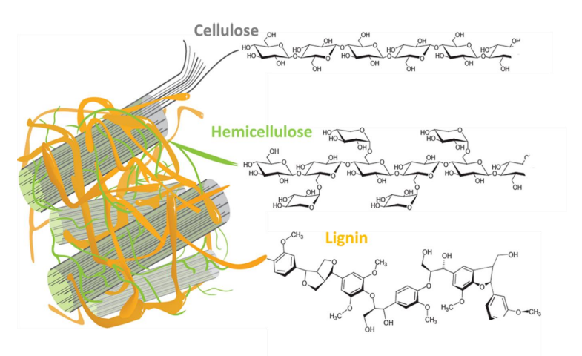
1.1 Fiber- Lignin
Lignin, along with cellulose and hemicellulose, are the three primary components that make up the cell walls of all plants.
Lignin is a complex, aromatic polymer, and acts as the essential glue, providing structural integrity to the plan cell wall and consequently the plant itself.
With the increasing awareness of sustainable development, higher-value utilizations of lignin have created much interest in different areas.
With all of the lignin available only 2% of the annual production is incorporated into value-added products
FIG:lignocellulose structure in plants cell wall Source:[https://trace.tennessee.edu/utk_graddiss/6634]
The notable properties of lignin, including high availability, low cost, ecologically friendliness as well as antioxidant, antimicrobial, biodegradable properties and reinforcing ability succeeds in exploiting as an ideal candidate for an extensive variety of applications

Slide 5
Complex nature of lignin reduces the reactivity, limiting the use as feedstock for value-added products
There are various functional groups present in the lignin structure which enable a variety range of chemical reactions.
The isolation of lignin in its unaltered and native form is impossible hence the discussion of extraction methods on lignocellulose biomass is essential when studying the implementation of lignin in Elastomeric composites.
Many extraction techniques with great progress are available currently for the isolation and purification of lignin, however, none of them can provide a 100% yield and structural authenticity
Sources | Lignin(%)
Hardwood | 18-25
Softwood | 25-35
Herbaceous | 10-30
FIG:Composition ranges in lignocellulosic materials from different sources (%) Source:[boa.unimib.it/retrieve/handle/10281/153251/218139/phd_unimib_063509]

Slide 6
2. Processing techniques
Extraction process of lignin
2.1
Sulfur process
Sulfur-free process
The properties of extracted lignin (so called technical lignin), and its chemical structure and purity are strongly dependent on the treatment method

Slide 7
2.2 Preparation of Lignin/SBR composite via melt compounding[16]
Lignin
Acetone
150 mL
Watch glass
39g SBS powders
Internal mixer
(5 mins)
Vacuum oven
(50℃ for 24 hrs)
Fume hood
S-lignin-X

Slide 8
3. Challenges and Remedies[6]
Issue 1:
Flocculation and filtration of lignin/SBR precipitates are extremely slow, which severely limits the application of lignin in the rubber industry
Issue 2:
Mixing lignin as dry powder with rubber, has no reinforcing effect.
Remedies:
Surface modification of lignin,
hybrid technologies with carbon black, silica, and layered double hydroxides (LDHs).

Slide 9
Findings:
Time consuming
Unsuitable for large-scale production
Poor lignin dispersion
Poor lignin–rubber interaction
Experiment 1:
The lignin/carbon black hybrid fillers could lower the viscoelastic loss of rubber compounds
Experiment 2:
The lignin–LDH hybrid fillers showed obvious reinforcing effect on SBR compared to layered double hydroxides (LDH).
Solutions [6]
Chemical modifications were applied on lignin macromolecules.
MIxing lignin in aqueous alkali solution.
Changing the surface activity of lignin.
Epoxidized natural rubber (ENR) as compatibilizer to improve both lignin dispersion and interfacial adhesion.

Slide 10
3.1 Chemical modification of lignin to Propylene oxide modified lignin (HL)
Lignin
20g
NaOH solution (0.1M)
300mL
1,2-propylene oxide
30g
500mL round bottom flask
Water bath at 70℃
slurry
H2SO4 solution
(1.0M)
Accelerate lignin aggregation
To adjust the pH value to 2
Oil bath at 35℃ for 10 hours
Propylene oxide modified lignin (HL)
Filtered and washed 3 times
Dried in a vacuum oven for 24 hours at 50℃

Slide 11
Slide 7
3.2 Preparation of Lignin/SBR Composite
Lignin/SBR Composite using melt compounding[16]
Filtered, water washed and vacuum dried at 50℃ for 24 hours
Coprecipitation
Adjusting pH value to 2.
H2SO4(1M) + flocculation in water at 90℃ for 2 hours
epoxidized natural rubber (ENR)
Vulcanization in a standard mold at 160℃
Heat treatment at 120℃ for 10 minutes
Open two roll mill process
S indicates SBR,
E indicates Epoxidized natural rubber(ENR) and
HL indicates Propylene oxide modified lignin.
SE-HL

Slide 12
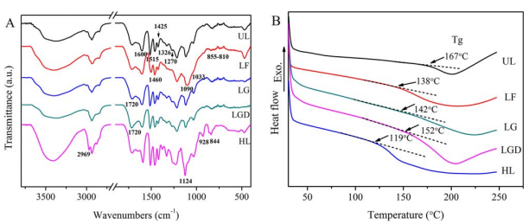
4. Performance of lignin-based elastomeric composites using different approaches[6]
4.1 FTIR and Tg
UL- Unmodified lignin
LF- Lignin modified by formaldehyde
LG- Lignin modified by glyoxal
LGD- Lignin modified by glutaraldehyde
HL- Propylene oxide modified lignin
Functional Groups | Wavenumber (cm-1)
C - H | 2850-3300 & 1480-1440
C＝O | 1680-1750
C - O | 1000-1300
O - H (alcohols) | 3230-3550
O - H (acids) | 2500-3300(very broad)
FIG: FTIR spectra (A) and DSC curves (B) of unmodified lignin (UL), lignin modified by formaldehyde (LF), glyoxal (LG), glutaraldehyde (LGD), and propylene oxide (HL)
Source: (https://onlinelibrary.wiley.com/doi/abs/10.1002/app.45759)
Formaldehyde in FL forms toxic properties
LG and LGD are very similar to that of UL
For Propylene oxide in HL, the intensity of the bands is stronger than UL.
Better dispersion of HL in the rubber matrix

Slide 13
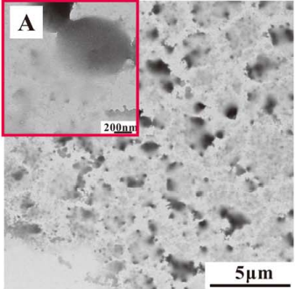
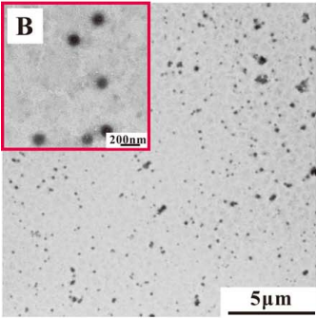
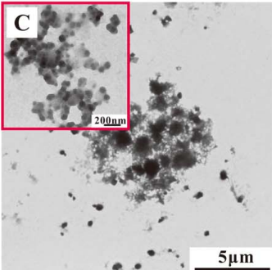
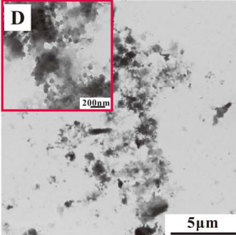
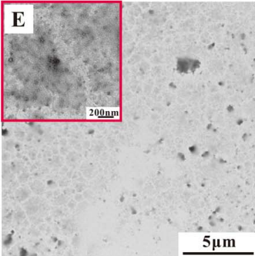
4.2 TEM Analysis
FIG: TEM images of unmodified lignin (UL, A), lignin modified by formaldehyde (LF, B), glyoxal (LG, C), glutaraldehyde
(LGD, D), and propylene oxide (HL, E). Insets: high magnification.
Source: (https://onlinelibrary.wiley.com/doi/abs/10.1002/app.45759)
(A):
UL molecules intensively self-aggregate into irregular fragments and interconnect together.
(B):
LF is converted to individually dispersed nanospheres with a diameter of about 100 nm.
(C) & (D):
LG and LGD also possess granular features, but they show a gradually decreased dispersity.
(E):
Fewer dark domains in HL, which implies less aggregation than UL.

Slide 14
4.3 Flocculation efficiency
Under heating for 30 minutes,
HL/ SBR mixture show an accelerated flocculation under heating.
Other lignin/SBR mixtures are still suspended as tiny agglomerates.
This improved flocculation is very beneficial for the industrial manufacture of lignin/SBR composites.
4.5 Mechanical properties
 | Tensile strength | Tear strength
SBR Or SBR/ENR | 2–3 MPa | ~10 KN/ m
SE-L | 15–19 MPa | 20–30 KN/m
Slight improvement of the maximal stress and tear strength of the rubber composites after adding ENR, except the HL filled SBR composites.
UL/SBR composites exhibit an optimal performance
FL/SBR composites exhibit ultimate maximal stress at smaller deformation.
Huge polarity difference between HL and SBR causes the deterioration of the performance.
After adding ENR, HL yields a higher reinforcing effect on SBR.
4.4 Viscoelastic Behavior
The results demonstrate that the addition of ENR can improve the wet skid resistance and reduce the rolling resistance of the rubber composites.

Slide 15
5. Application in Automotive parts
One of the major applications of elastomer is in the field of tire manufacturing.
Today, tyre manufacturers constitutes 70 % of world consumption of synthetic rubbers.
Styrene butadiene (SBR) and butadiene (BR) are most the most common rubber polymer in the tyre industry.
SBR is compatible with natural rubber and has a low cost.
The chemical and physical properties of these rubbers have a great impact on the overall tyre performance (wear, traction and rolling resistance).
The lowering of rolling resistance value is an important criterion for the preparation of green tyre compounds.
Especially, in the presence of ENR, HL is uniformly dispersed throughout the rubber matrix and exhibits a clear reinforcing effect on SBR.
HL filled SBR/ENR composites show a superior wet skid resistance and low rolling resistance. This opened up an opportunity for us to industrially manufacture safe and green rubber tires.

Slide 16
6. Conclusion
Due to the increasing demands of automotive and trucks, the tyre market is heavily increasing with a global production of billions of tyres per year.
Tyre industry is extensively reliant on petroleum and non-renewable materials.
Numerous toxicological researches highlight that Carbon black(reinforcing filler on tyres) may act as a universal carrier of wide variety of chemicals of varying toxicity to the human body.
Numerous researcher endeavours in finding eco-friendlier substitutes for the petroleum-based composites.
In the rubber tire industry, the property of major concern is the rolling resistance.
In the papers discussed, we were able to create SE-HL composite with a rolling resistance suitable for the tyre manufacturing.
With the increasing awareness of sustainable development, higher-value utilizations of lignin have created much interest in different areas.

Slide 17
18
7. Reference
[1] Ismail, M. A. (2020). Modified lignin as replacement of carbon black in elastomers- For the development of sustainable tyre technology, 1–58.
[2] Roy, K., Debnath, S. C., & Potiyaraj, P. (2020, February 1). A Review on Recent Trends and Future Prospects of Lignin Based Green Rubber Composites. Journal of Polymers and the Environment. Springer. https://doi.org/10.1007/s10924-019-01626-5
[3] Nagardeolekar, A., Ovadias, M., Dongre, P., & Bujanovic, B. (2021). Prospects and Challenges of Using Lignin for Thermoplastic Materials. In ACS Symposium Series (Vol. 1377, pp. 231–271). American Chemical Society. https://doi.org/10.1021/bk-2021-1377.ch010
[4] Ngamkham, R., Prapainainar, P., Roddecha, S., & Dittanet, P. (2021). Production of Composite Fibers from Natural Rubber and Lignin. Engineering Journal, 25(4), 79-85.
[5] Ikeda, Y., Phakkeeree, T., Junkong, P., Yokohama, H., Phinyocheep, P., Kitano, R., & Kato, A. (2017). Reinforcing biofiller “lignin” for high performance green natural rubber nanocomposites. RSC advances, 7(9), 5222-5231.
[6] Jiang, C., He, H., Yao, X., Yu, P., Zhou, L., & Jia, D. (2018). The aggregation structure regulation of lignin by chemical modification and its effect on the property of lignin/styrene-butadiene rubber composites. Journal of Applied Polymer Science, 135(5), 45759
[7] Barana, D., Orlandi, M., Zoia, L., Castellani, L., Hanel, T., Bolck, C., & Gosselink, R. (2018). Lignin-based functional additives for natural rubber. ACS sustainable chemistry & engineering, 6(9), 11843-11852.

Slide 18
[8] Huang, J., Liu, W., & Qiu, X. (2019). High-performance thermoplastic elastomers with biomass lignin as a plastic phase. ACS Sustainable Chemistry & Engineering, 7(7), 6550-6560.
[9] Ikeda, Y., Phakkeeree, T., Junkong, P., Yokohama, H., Phinyocheep, P., Kitano, R., & Kato, A. (2017). Reinforcing biofiller “lignin” for high-performance green natural rubber nanocomposites. RSC advances, 7(9), 5222-5231.
[10] Datta, J., & Parcheta, P. (2017). A comparative study on selective properties of Kraft lignin–natural rubber composites containing different plasticizers. Iranian Polymer Journal, 26(6), 453-466.
[11] Datta, J., Parcheta, P., & Surówka, J. (2017). Softwood-lignin/natural rubber composites containing novel plasticizing agent: Preparation and characterization. Industrial Crops and Products, 95, 675-685.
[12] Intapun, J., Rungruang, T., Suchat, S., Cherdchim, B., & Hiziroglu, S. (2021). The Characteristics of Natural Rubber Composites with Klason Lignin as a Green Reinforcing Filler: Thermal Stability, Mechanical and Dynamical Properties. Polymers, 13(7), 1109.
[13] Mohamad Aini, N. A., Othman, N., Hussin, M. H., Sahakaro, K., & Hayeemasae, N. (2019). Hydroxymethylation-modified lignin and its effectiveness as a filler in rubber composites. Processes, 7(5), 315.
[14] Barana, D. (2017). Lignin-based elastomeric composites for sustainable tyre technology. University of Milano-Bicocca, Italy.
[15]Bova, A. S. (2021). Stretching the applications of biomass: Development of lignin based thermoplastic elastomers and composite materials.
[16] Xiao, L., Liu, W., Huang, J., Lou, H., & Qiu, X. (2020). Study on the Antioxidant Activity of Lignin and Its Application Performance in SBS Elastomer. Industrial & Engineering Chemistry Research, 60(1), 790-797.

